Slide 1
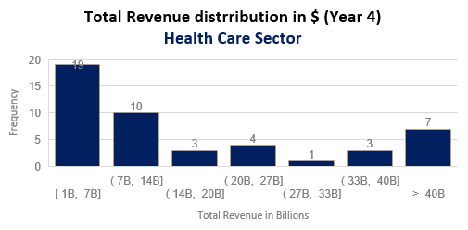
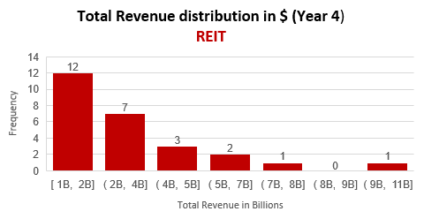
What sector, REIT or Healt Care, generated more money from their core revenue-driving operations in Year 4?
Distributions of both sectors are right or positively highly skewed (skewness of REIT is 1.95, skewness of Health Care is 1.86) Mean is greater than median: 2.9B > 2.4B for REIT and 46.5B > 22.8B for Health Care. The outliers of the distribution curve are further out towards the right and closer to the mean on the left. There is a significant difference in value range which is 10.1B with Max value= 10.9B and Min value= 0.8B for REIT and 182B with Max value= 191B and Min value= 9B for Health Care. REIT’s kurtosis is a leptokurtic distribution (4.7), concentrated toward the mean. The outliers stretch the horizontal axis of the histogram graph and make the bulk of the values appear in a narrow vertical range. Health Care Sector’s kurtosis is a platykurtic distribution (2.44), leading to less extreme outliers. Standard deviation for REIT is 2.3B and less than mean, meaning values are clustered around the mean. Standard deviation for Health Care sector is 54B and is more than mean , it indicates values are more spread out.

